Slide 1
Chapter 19

Slide 2
Objectives

Slide 3
Objectives (cont.)

Slide 4
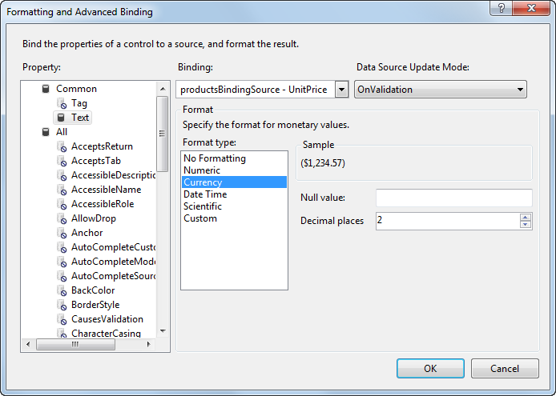
The dialog box for formatting a column

Slide 5
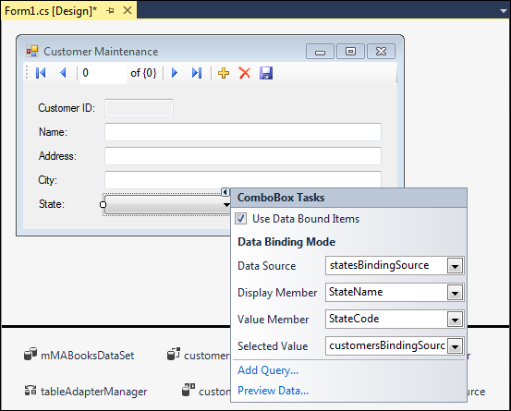
A combo box that’s bound to a data source

Slide 6
Combo box properties for binding

Slide 7
Common properties of the BindingSource class

Slide 8
Common methods of the BindingSource class

Slide 9
A statement that adds a new row to a data source

Slide 10
Code that moves to the next row and displays the position and count

Slide 11
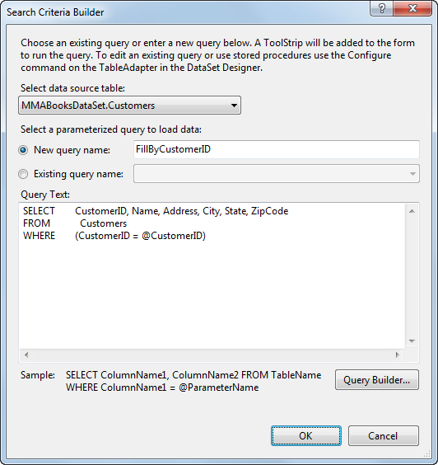
The dialog box for creating a parameterized query

Slide 12
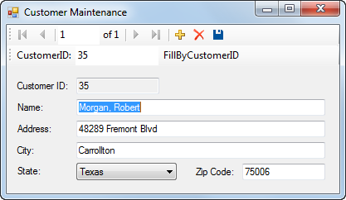
The Customer Maintenance form with a toolbar

Slide 13
The generated code for a parameterized query

Slide 14
The same code after it has been improved

Slide 15
The syntax of the method for filling a table using a parameterized query

Slide 16
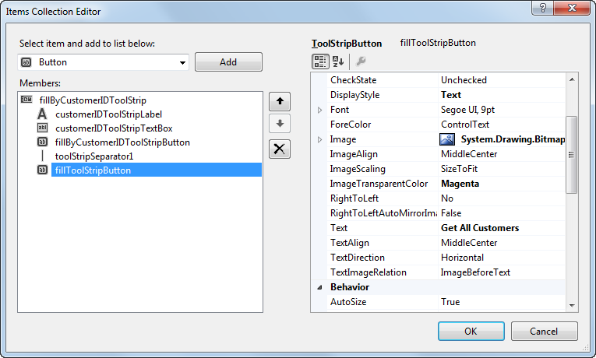
The Items Collection Editor for a ToolStrip control

Slide 17
Common properties of ToolStrip items

Slide 18
Customized toolbars

Slide 19
The event handler for the Get All Customers ToolStrip button

Slide 20
The event handler for the Get Customer ToolStrip button

Slide 21
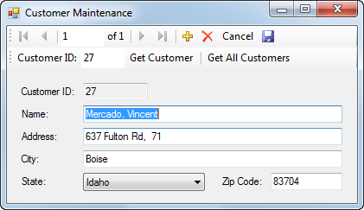
The Customer Maintenance application

Slide 22
The code for the Customer Maintenance application

Slide 23
The code for the application (cont.)

Slide 24
The code for the application (cont.)

Slide 25
The code for the application (cont.)

Slide 26
The code for the application (cont.)

Slide 27
The code for the application (cont.)

Slide 28
The code for the application (cont.)

Slide 29
The code for the application (cont.)

Slide 30
The code for the application (cont.)

Slide 31
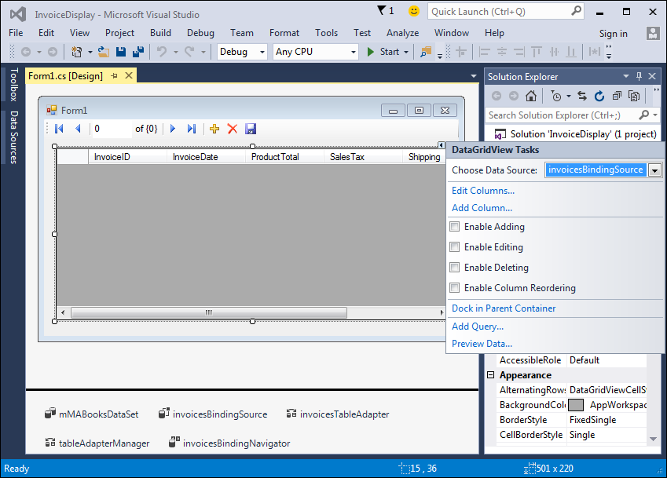
The smart tag menu for a DataGridView control

Slide 32
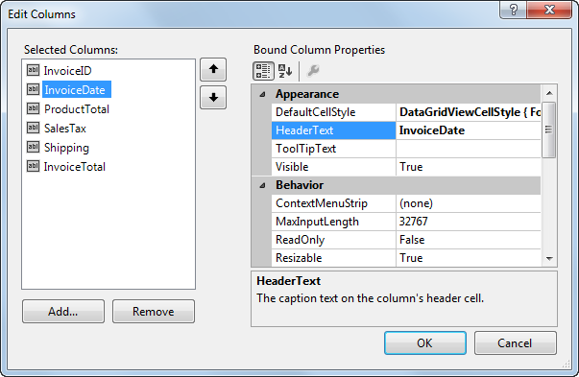
The dialog box for editing DataGridView columns

Slide 33
Common properties of a column

Slide 34
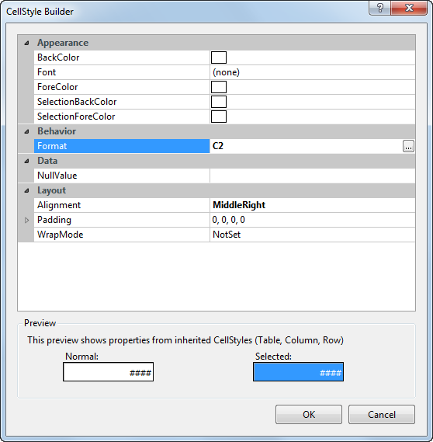
To format columns: The CellStyle Builder dialog box

Slide 35
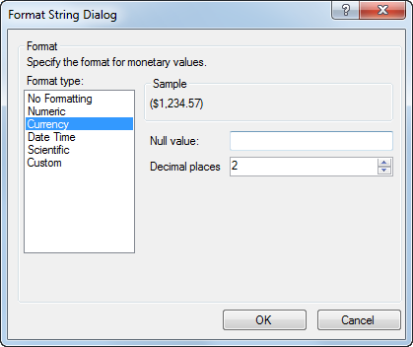
To format columns: The Format String dialog box

Slide 36
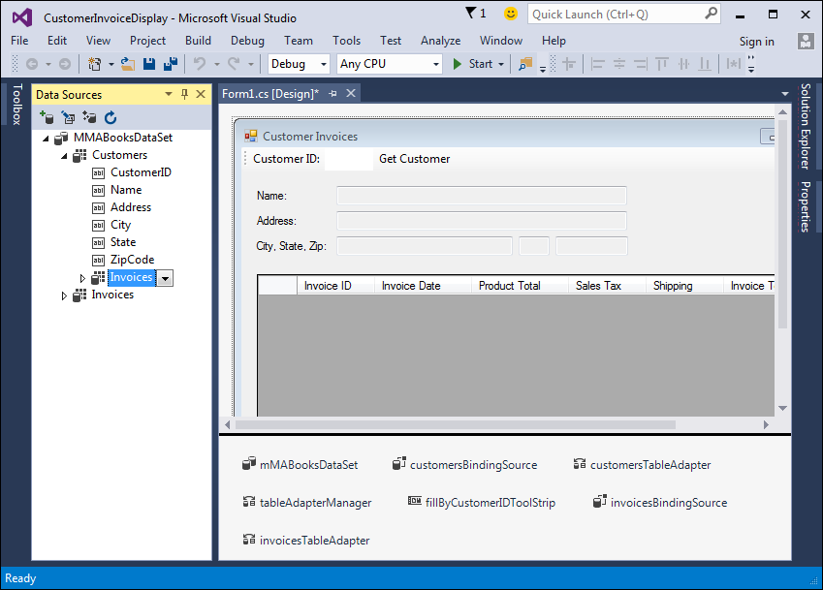
A form that uses a DataGridView control to display data from a related table

Slide 37
Two BindingSource properties for displaying data from a related table

Slide 38
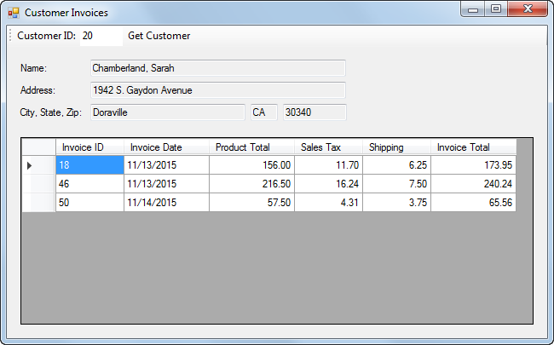
The Customer Invoices form

Slide 39
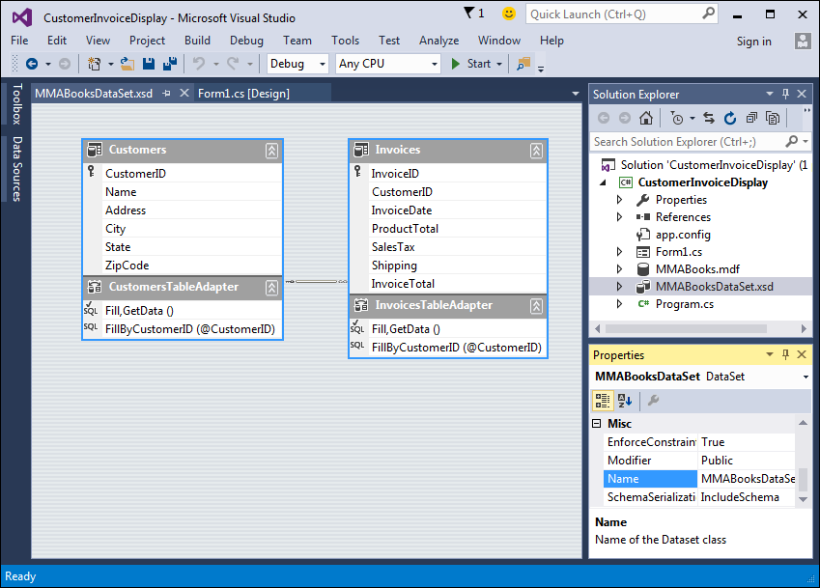
The dataset schema

Slide 40
The code for the Customer Invoices form

Slide 41
The code for the Customer Invoices form (cont.)

Slide 42
Extra 19-1 Add a parameterized query to the Product Maintenance form

Slide 43
Extra 19-2 Create a Master/Detail form

Slide 44
Project 4-3 Display customer incidents

Slide 45
Project 4-4 Add customer incidents

